Slide 1
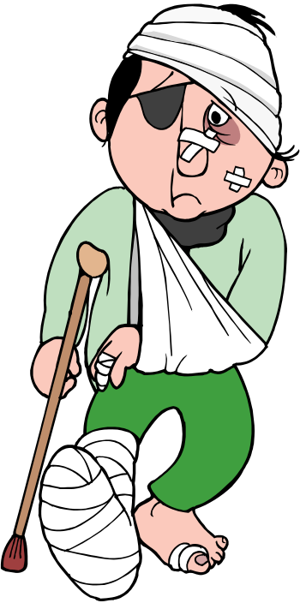
The Simple Past: Yes/No and Wh- Questions
6
An Accident

Slide 2
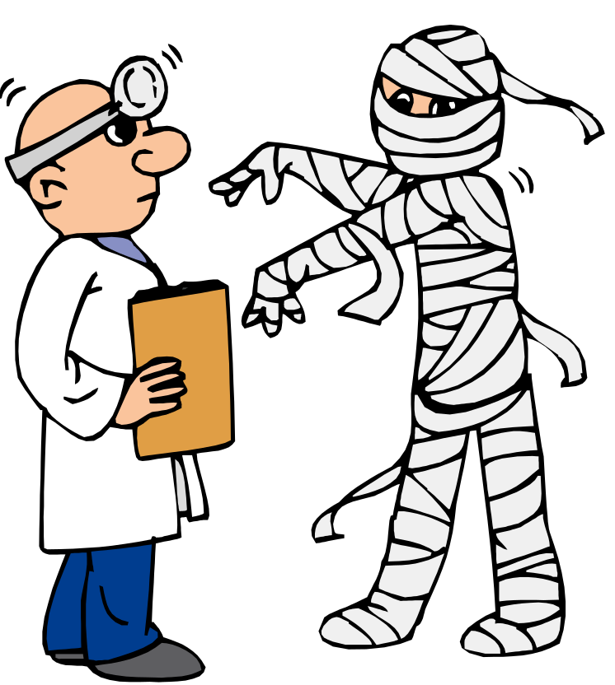
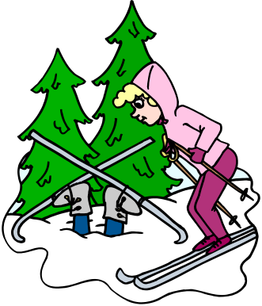

What happened?
No, they didn’t. They had a flat tire.
So, how did you hurt yourself?
Another skier called the paramedics.
I wasn’t careful. I didn’t see the tree.
Did the paramedics arrive quickly?
Ouch! Who called for help?

Slide 3

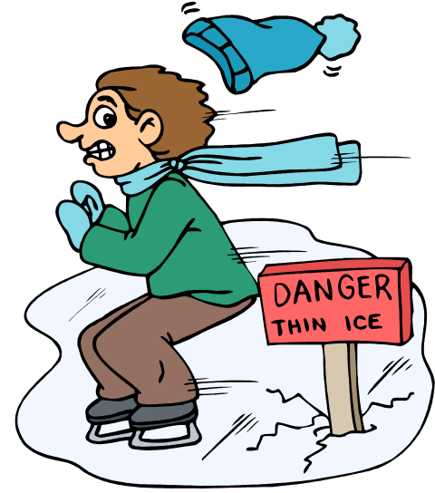
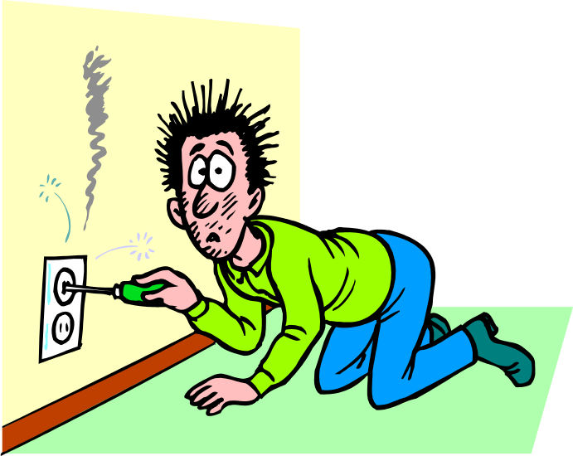
Yes/No Questions
Use did + subject + base form for yes/no questions in the simple past, except for the verb be.
Did you see the sign?
Was he careful?

Slide 4
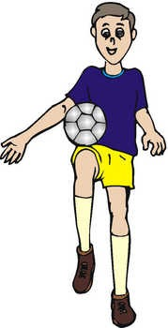
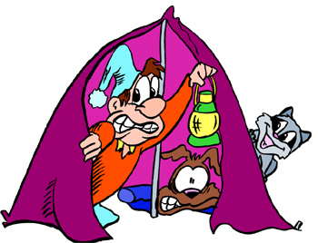
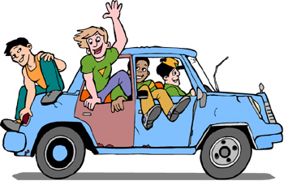
Practice 1
Use the words above the pictures to make yes/no questions in the past.
you/afraid
Example:
he/practice
1.
Did he practice?
Were you afraid?
2.
they/have fun
it/heavy
3.
Was it heavy?
Did they have fun?

Slide 5
Wh- Question Word Order
Wh- Word
Did
Subject
Base Form of Verb
When
did
the ambulance
arrive?
Where
did
the accident
happen?
Who
did
you
call?

Slide 6
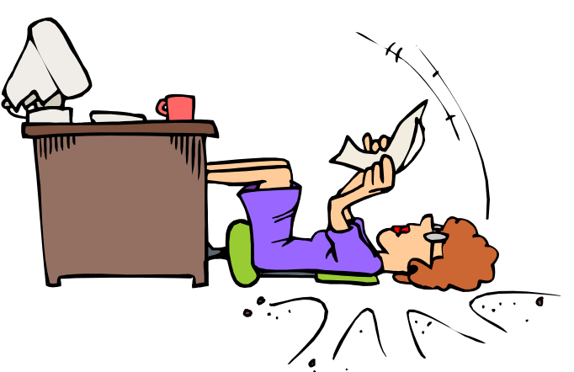
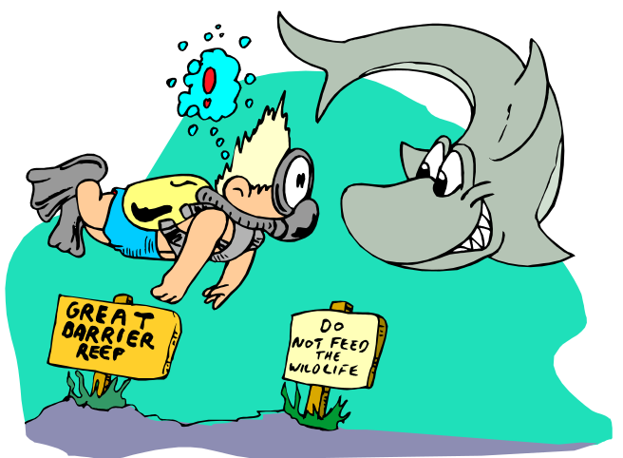
Wh- Questions 1
Most wh-questions in the past use a base form verb with did.
fall
Where did she ?
falls
How did they ?
met
meet

Slide 7
Practice 2
Make wh- questions for the colored parts of the answers.
Example: The accident happened on the first floor.
Where did the accident happen?
1. Ali called the paramedics.
Who did Ali call?
2. Hector had an accident yesterday.
When did Hector have an accident?
3. Lee and Ben fell because they weren’t careful.
Why did Ben and Lee fall?

Slide 8
Short and Long Answers 1
We use short and long answers to yes/no questions.
Yes, it did.
It was very painful.
Did it hurt?

Slide 9

Short and Long Answers 2
We also use short and long answers to wh- questions.
Cried.
I cried like a baby.
What did you do?

Slide 10

Practice 3
Ask and answer the questions below with a partner. Use short and long answers.
How was your weekend?
What did you do?
Did you have fun?
Where did you go?
Did you do any homework?
Who were you with?

